Slide 1
Applied Data Science Capstone
Elyse Hallstrom
Phoenix Restaurant location selection

Slide 2
Problem
Our client wants to know where to open a new Gastropub in Phoenix, AZ so that they have the best chances of being successful.

Slide 3
Background
Our client is a well-known restauranteur in the US, but has no restaurants in Phoenix, AZ yet.
They would like to open a new Gastropub.
They need to know where would be the best place to lease restaurant space.
Their Gastropub will be on the pricier end of the spectrum, so they’d like to target people with higher incomes that can afford to eat there.
They also would like to be in an area where Gastropubs are popular so there is a proven track record of demand for that type of restaurant.

Slide 4
Audience
This methodology is of interest to any type of business that is looking to know where to open a location based on income level in that zip code.

Slide 5
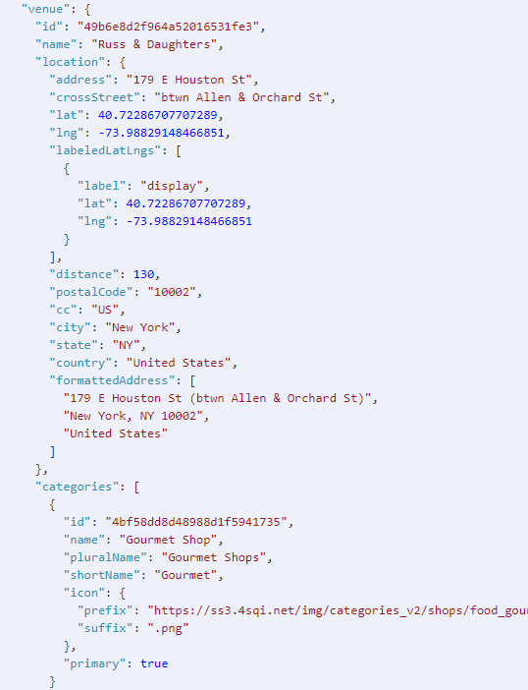
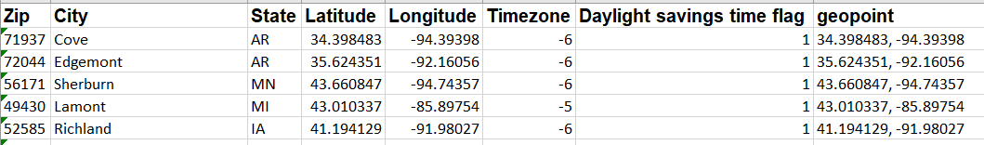
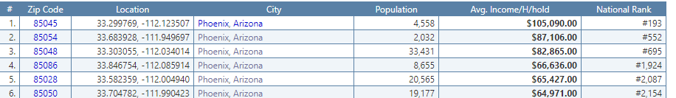
The Data
For the location data, we will use the Foursquare API explore to find the types of venues in each zip code.
We will use zip code data from Open Datasoft to get the longitude, latitude, and city for each zip code.
We will get the average household income by zip code from Zip Atlas.

Slide 6
Data Exploration
Methodology section which represents the main component of the report where you discuss and describe any exploratory data analysis that you did, any inferential statistical testing that you performed, if any, and what machine learnings were used and why.

Slide 7
Methodology
Methodology section which represents the main component of the report where you discuss and describe any exploratory data analysis that you did, any inferential statistical testing that you performed, if any, and what machine learnings were used and why.

Slide 8
Results
Results section where you discuss the results.

Slide 9
Discussion
Discussion section where you discuss any observations you noted and any recommendations you can make based on the results.

Slide 10
Conclusion
Conclusion section where you conclude the report.

